Slide 1
Capstone Final
Finding Places to Live Similar to Home
Benjamin McDougal

Slide 2
Introduction
The Audience
My Audience is my Family and anyone else who wants to live in a quieter, less populous area, without all the fancy attractions but still has stuff to do similar to my Hometown of Idaho Falls, Idaho
The Background
Many young people are looking for new jobs and places to live. They including myself would like a place similar to where they grew up if at all possible. Directly with my comparison my city I grew up in is small enough that many would laugh at it being called a city at around 60,000 people and about 5 square miles. Jobs are more limited to a few big employers or owning/managing your own business. Thus, I and many other young adults are looking at moving to bigger cities even if that is not ideal for our lifestyle, habits, and upbringing.

Slide 3
Question
Are there other Counties similar to the one I grew up other places in the Nation where job opportunities and wages are better?

Slide 4
Limitations to Answering the Question
As there are several thousand cities in America with great differences in size. I have decided instead of using cities to use counties which are a more equal distribution and manageable.
Also, I am going to further restrict the counties to ones that are more similar in population as well to further balance the scale appropriately. I will work with counties between 50,000 and 500,000 thousand people.
I am basing similarity of counties on venue types as I believe that reflects the culture and wealth of the area quite well. That alongside the population should allow me to find areas similar to where I grew up.

Slide 5
Data
Outside of Foursquare
I will use the county name and population columns of the table of American county information as from Wikipedia’s list here Wikiepdia American Counties
County names lets me group my data geographically. County Population helps to define similarity between counties.
Within Foursquare
I also will use Foursquare data of venue types as a measure of similarity of culture and wealth of the county.

Slide 6
Methodology
Step 1- Import libraries, functions and data
Step 2 Wrangle the Data
Step 3 Get Venues
Step 4 Onehot and Combine with Latitude and Longitude Values
Step 5 Run K-Means

Slide 7
Step 1 Import libraries, functions and data
Import Libraries
Create get venues function
Import Data
With this I noted that the index for the table from the Wikipedia page on the data import is 3. That and in reading through the FourSquare API documentation. I learned FourSquare will automatically geocodes for me. I also found that using near instead of providing the latitude and longitude caused foursquare to automatically base the radius on density of venues.

Slide 8
Step 2 Wrangle the Data
Firstly, I selected only the relevant columns
With that I dropped any NA values this gave me a list of about 870 counties total
Then due to the FourSquare rate limit on a free account of about 950 non-premium requests a day I decided to only use a sample of 150 counties.

Slide 9
Step 3 Get Venues
Here we use a function to obtain the venues for our entire county list.
I used a limit of 25 venues
As noted above I used near without a radius to allow FourSquare to choose a radius and venues according to its internal default of most densely located venues.
With this we grab the venues category and location.

Slide 10
Step 4 Onehot and Combine with Latitude and Longitude Values
Onehot or dummy encode our venue categories
Then group by the county by the average of each category type.
Above with the lat and long values in the group by we have to find the approximate center of each group of points to get one good lat and long location for each county.
. I am doing this by averaging the coordinates which will give alright results in small areas
Find the index of our original home county
In my case this was 12

Slide 11
Step 5 Run K-Means
The final step is to run K-means to create groups of similar counties based on venue information so we need to drop the county name and location columns.
Then we do some trial and error to find a good k. In then end, I went with 10 for k. The final thing we do here is to then merge the cluster labels onto the original full data set

Slide 12
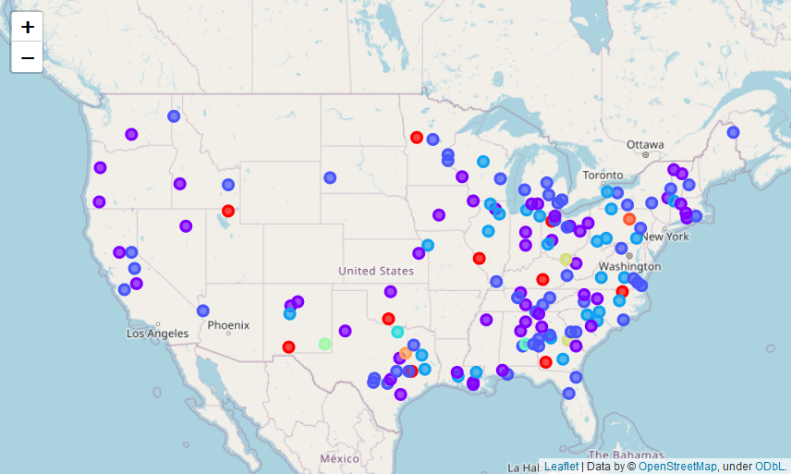
Map

Slide 13
List of Places
1 Aiken, South Carolina, USA
4 Aroostook, Maine, USA
6 Autauga, Alabama, USA
7 Baldwin, Alabama, USA
12 Bonneville, Idaho, USA
14 Brazos, Texas, USA
18 Calumet, Wisconsin, USA
20 Catawba, North Carolina, USA
21 Catoosa, Georgia, USA
23 Chisago, Minnesota, USA
26 Clay, Florida, USA
27 Clinton, Michigan, USA
29 Columbia, Georgia, USA
32 Crow Wing, Minnesota, USA
40 Fairbanks North Star Borough, Alaska, USA
43 Franklin, New York, USA
45 Genesee, New York, USA
46 Grafton, New Hampshire, USA
47 Guadalupe, Texas, USA
51 Hampton, City of, Virginia, USA
54 Hernando, Florida, USA
57 Hunt, Texas, USA
58 Jackson, Georgia, USA
59 James City, Virginia, USA
60 Jefferson, West Virginia, USA
66 Knox, Tennessee, USA
67 Kootenai, Idaho, USA
74 Lee, Alabama, USA

Slide 14
List of Places cont.
75 Lenawee, Michigan, USA
83 McCracken, Kentucky, USA
85 McMinn, Tennessee, USA
86 Medina, Texas, USA
88 Midland, Michigan, USA
90 Mohave, Arizona, USA
91 Muscogee, Georgia, USA
92 Muskegon, Michigan, USA
95 Newport, Rhode Island, USA
100 Pender, North Carolina, USA
101 Pennington, South Dakota, USA
102 Pike, Kentucky, USA
103 Placer, California, USA
107 Portage, Ohio, USA
110 Richland, Ohio, USA
113 San Benito, California, USA
116 Schuylkill, Pennsylvania, USA
118 Shiawassee, Michigan, USA
122 Steuben, New York, USA
126 Taylor, Texas, USA
129 Troup, Georgia, USA
130 Tuolumne, California, USA
133 Van Zandt, Texas, USA
135 Virginia Beach, City of, Virginia, USA
136 Washington, Minnesota, USA
137 Washington, New York, USA
141 Williamson, Tennessee, USA

Slide 15
Discussion
In the end I went with 10 for k as that gave me a result list of around 50 to 60 places out of the 150 sample I started with. I think the high k was necessary due to the large number of counties and would probably have to be higher with the full list of counties I had initially with ~870 counties. Interestingly, each time I ran k-means with the same k I got very similar results and my target group seemed to stay fairly consistent. This in my opinion shows that the analysis is valid.
From the map we can easily find the home county of Bonneville, Idaho if you know Idaho geography (it is in the southeast part of the state). Also, it turns out that there are many places that are similar. None of them are right in big cities but near them. This is good as it means that there are multiple places to live similar to my home county that will due to proximity to bigger cities likely have better jobs and wages.

Slide 16
Conclusion and Final Thoughts
With the final results, it would be beneficial to do a secondary analysis of those areas with additional demographic, housing, price, and job data. However, that is outside the scope of this analysis which was simply to find similar areas.
Based on the results, I would suggest living where work can be found. As with either a reasonable commute or some effort in the job hunting, one can find a place like home in more places than they would initially think.

